Slide 1
Quantifying Habitat Capacity
Presenters:
Tom Curet – Regional Supervisor, Idaho Department of Fish and Game
Chris Beasley – Director of Applied Biological Services – Biomark, Inc.
Cast of characters – dedicated technicians, biologists, scientists, biometricians…
Funding – federal, state, tribal, non-profit, not-for-profit.

Slide 2
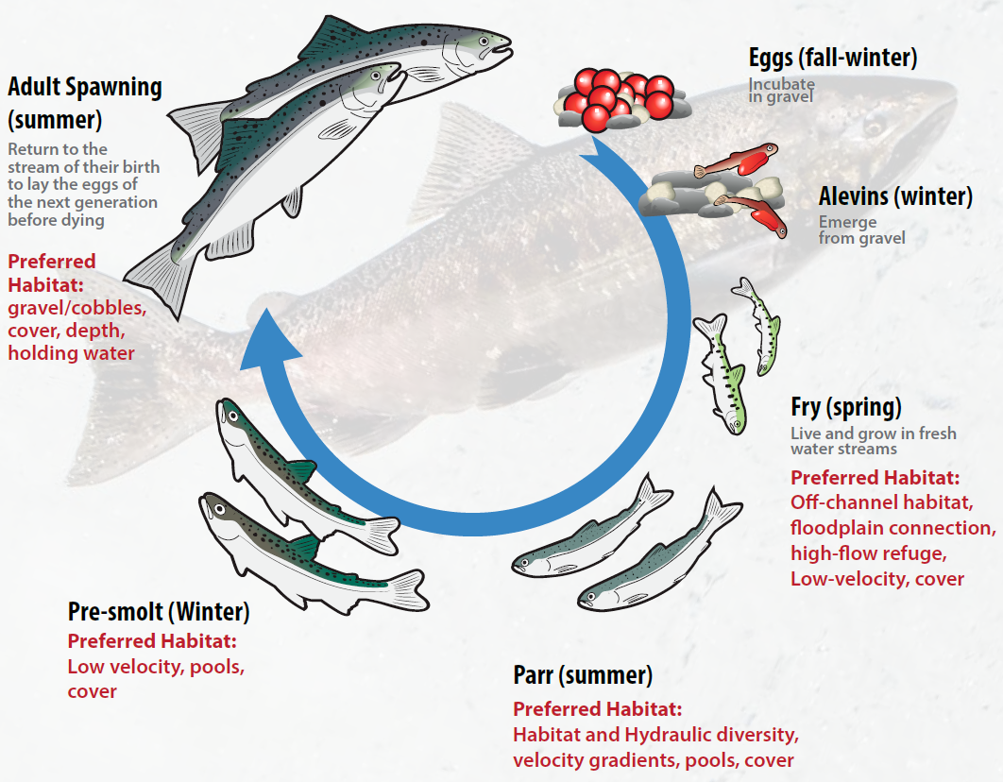
Content
Adult to smolt – tributary habitat.
Habitat capacity – density-dependence.
Habitat alteration – Tom Curet.
How much capacity do we need?
How much capacity do we have?
Why looks can be deceiving.
Temperature.
Conclusions!
ASK QUESTIONS!

Slide 3
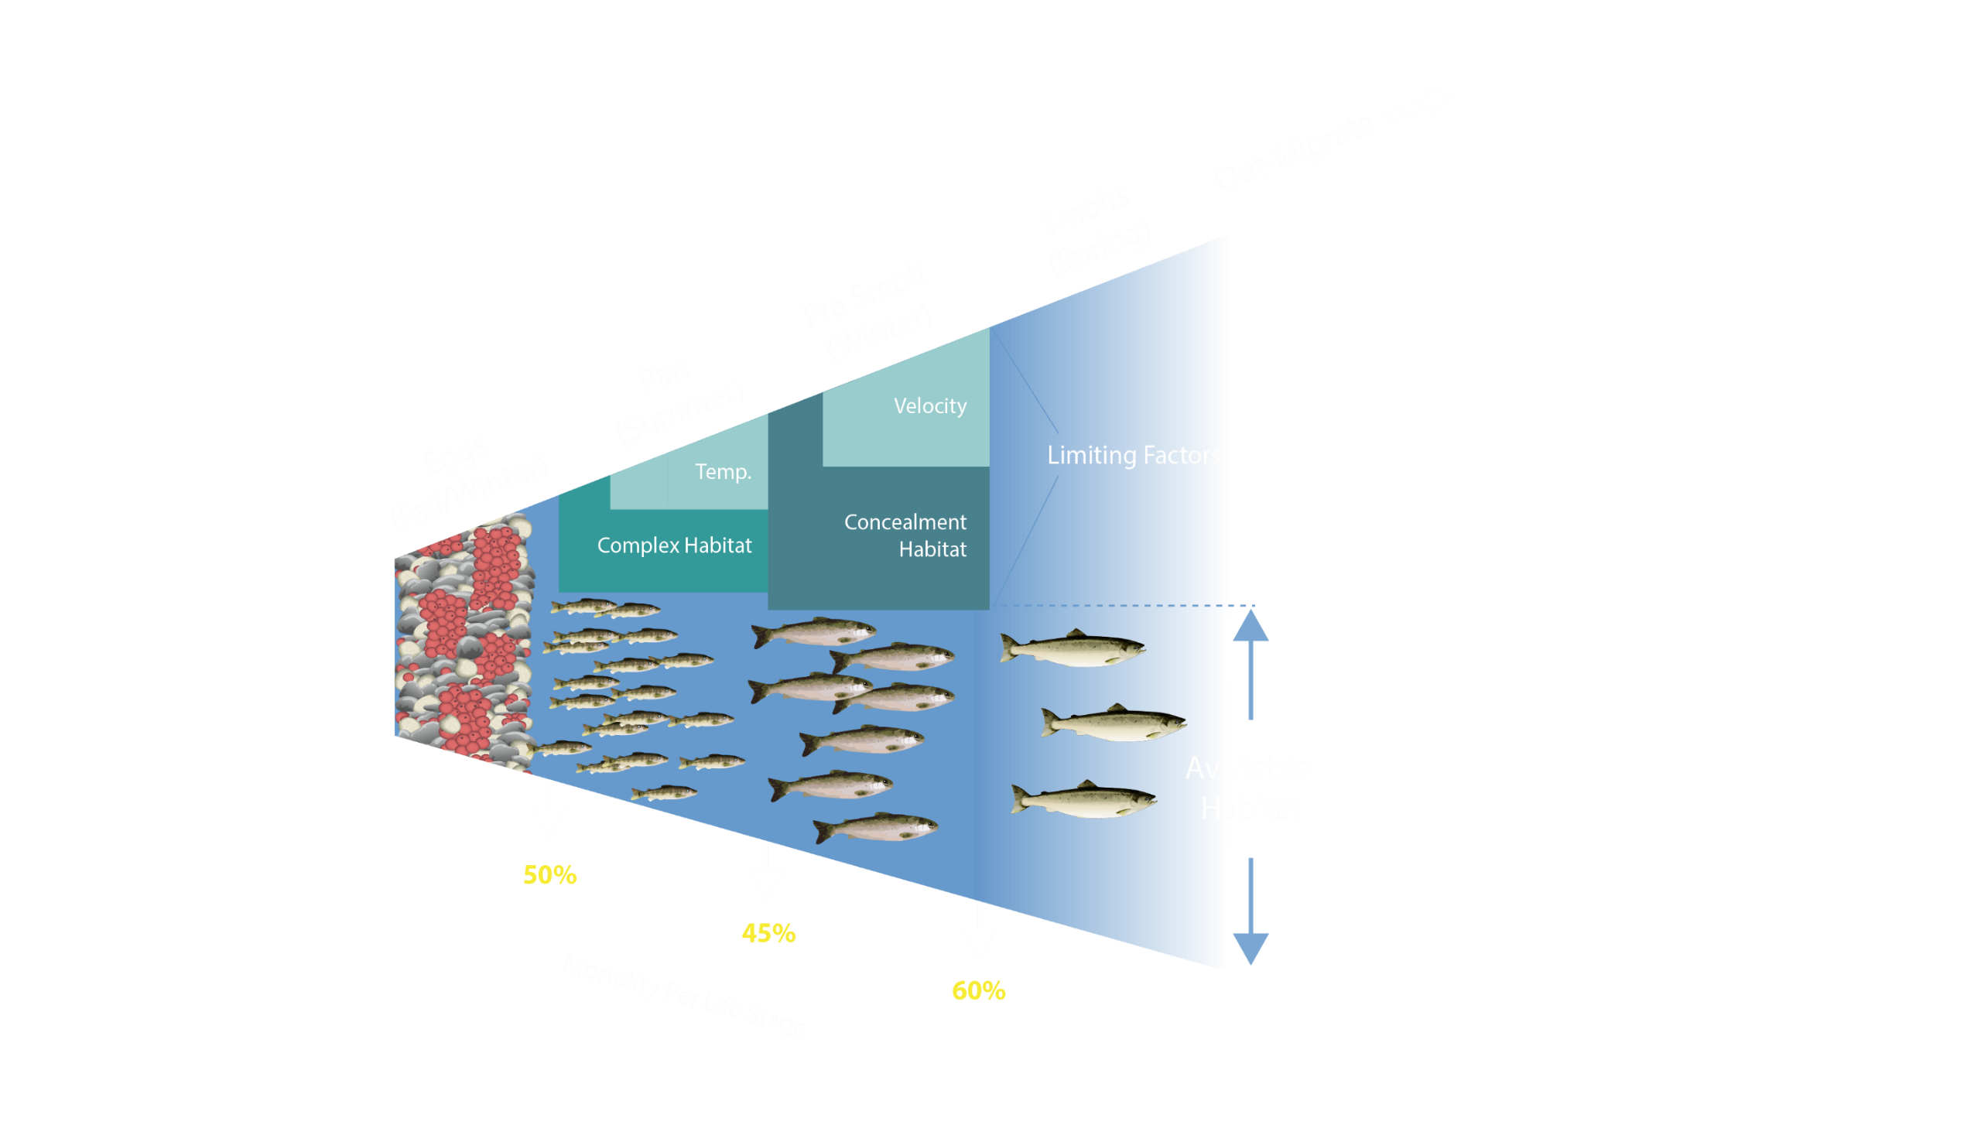
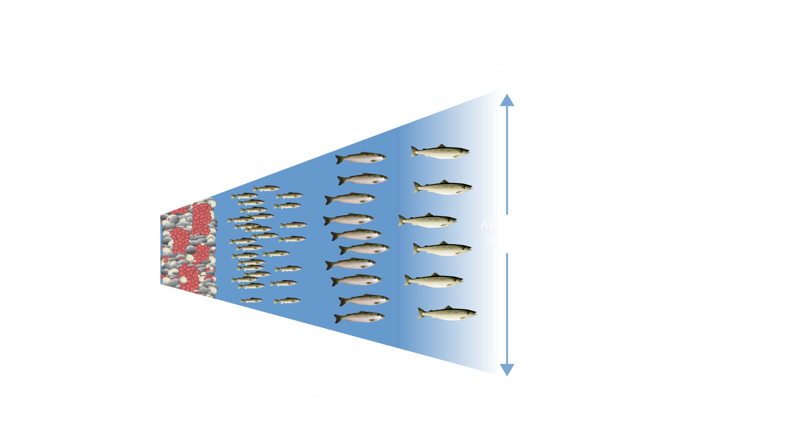
What is capacity?
Habitat Capacity: Optimal
Habitat Capacity: Actual

Slide 4
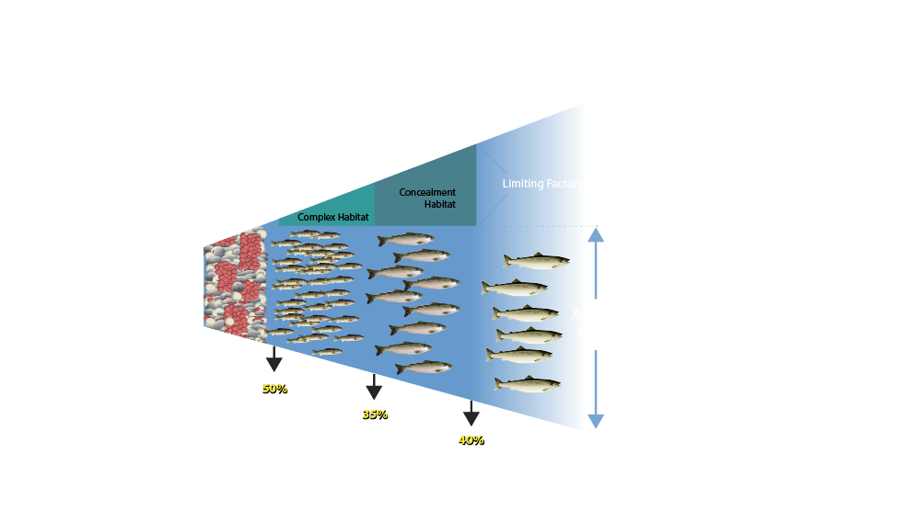
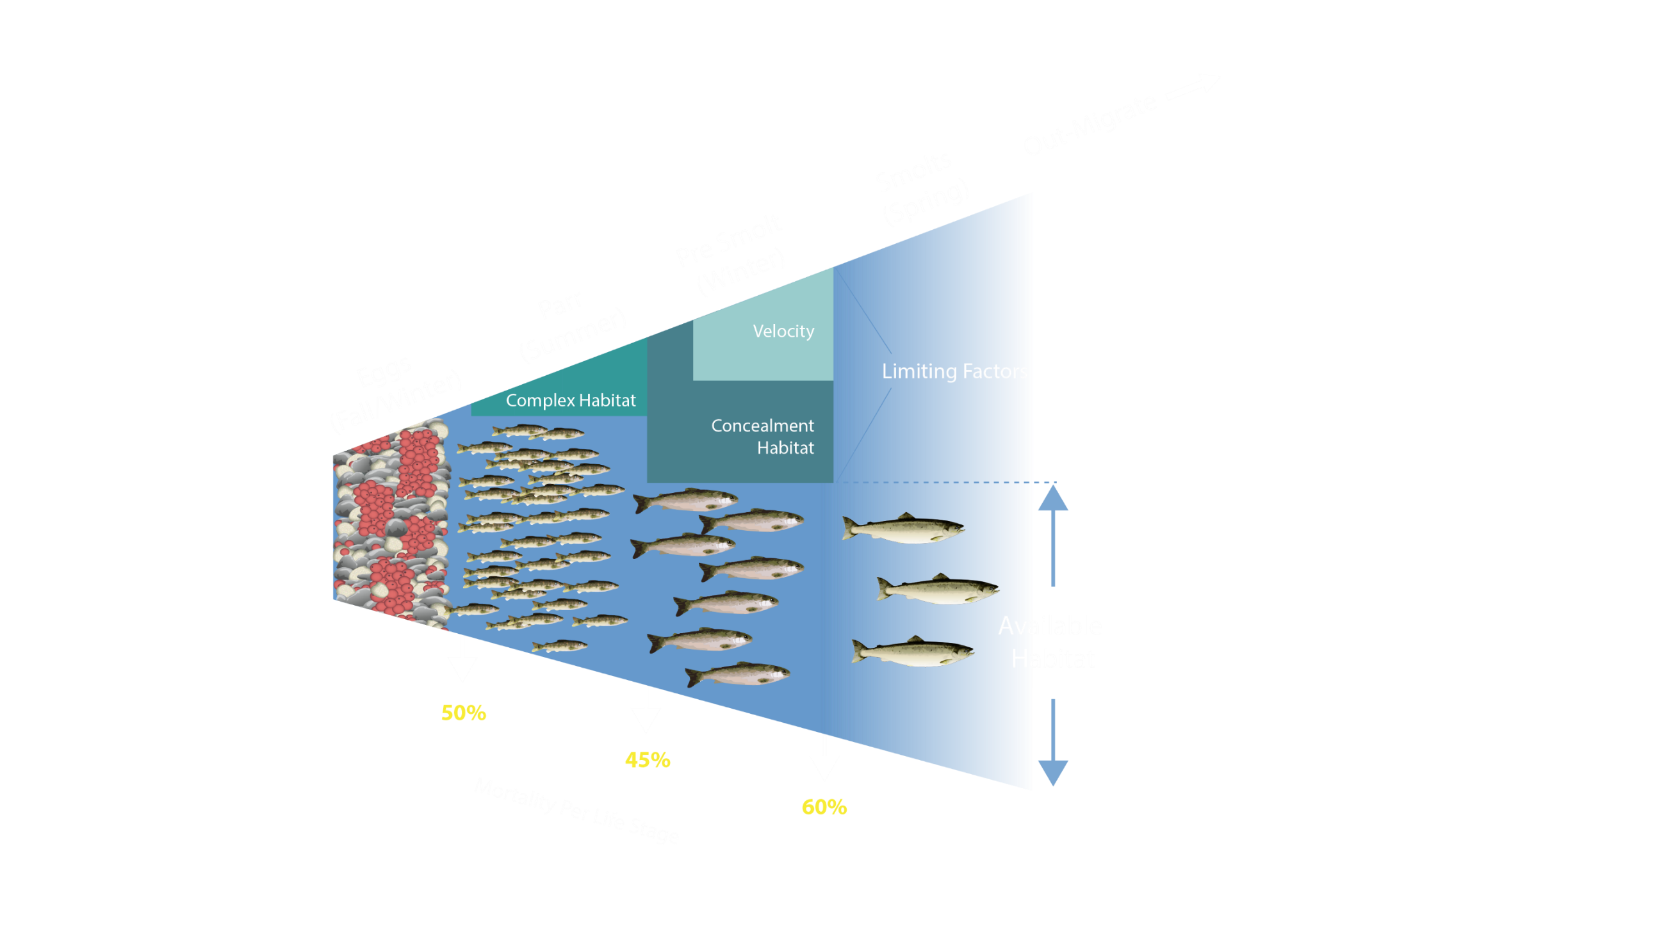
What is capacity?
50%
50%
50%
35%
60%
40%

Slide 5
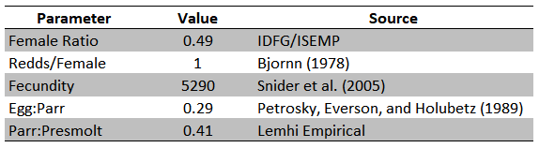
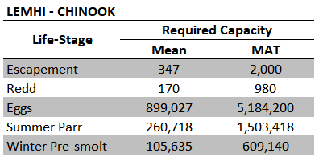
How much capacity do we need?
Model Parameters
Model Estimates

Slide 6
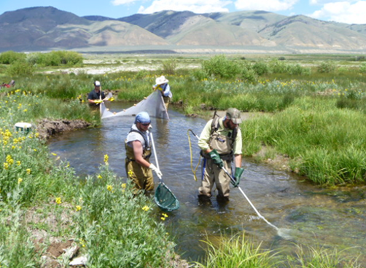


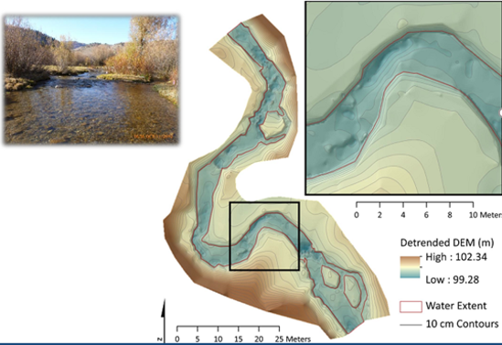
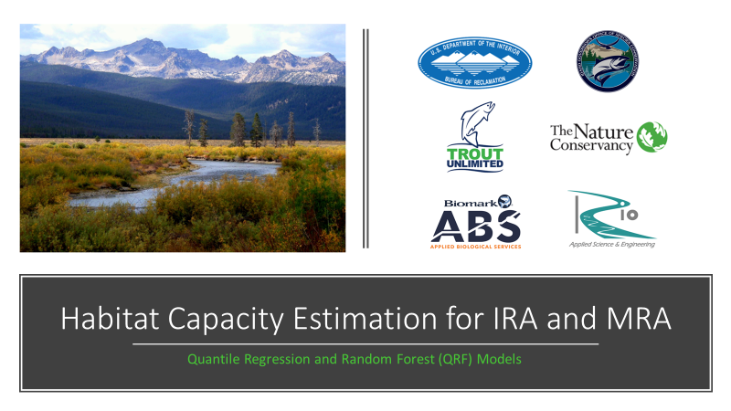
How much capacity do we have?
Quantile Random Forest (QRF) - Empirically-Based Fish/Habitat Relationship

Slide 7
Building a Quantile Random Forest Model
Which metrics are most useful (≈ 165 habitat metrics)?
  Maximal Information-based Nonparametric Exploration (MINE)
  Maximal Information Coefficient (MIC)
    substrate example – sand and fines, boulders, cobbles, D16, D50, D84, <2mm, <6mm…
  Why? Random Forest models don’t “over-fit.”
Machine learning (random forest classification):
  select 70% of data – fish abundance + 3 of X habitat attributes – lather, rinse, repeat ≈ 100,000 times
  each combination of metrics = one fish abundance estimate
  trim “best-performers” – combinations that predict abundance
  test using remaining 30% of data
Use upper-Quantile (e.g., 90%) to approximate capacity.
Validation:
  jackknife
  empirical

Slide 8
Building a QRF
Fish Density | Habitat Metric 1 | Habitat Metric 2 | Habitat Metric 3 | Habitat Metric 4 | … | Habitat Metric 12
1 | 1 | 1 | 1 | 1 | 1 | 1
2 | 2 | 2 | 2 | 2 | 2 | 2
3 | 3 | 3 | 3 | 3 | 3 | 3
4 | 4 | 4 | 4 | 4 | 4 | 4
5 | 5 | 5 | 5 | 5 | 5 | 5
6 | 6 | 6 | 6 | 6 | 6 | 6
7 | 7 | 7 | 7 | 7 | 7 | 7
8 | 8 | 8 | 8 | 8 | 8 | 8
… | … | … | … | … | … | …
272 | 272 | 272 | 272 | 272 | 272 | 272

Slide 9
Building a QRF
Fish Density | Habitat Metric 1 | Habitat Metric 2 | Habitat Metric 3 | Habitat Metric 4 | … | Habitat Metric 12
1 | 1 | 1 | 1 | 1 | 1 | 1
2 | 2 | 2 | 2 | 2 | 2 | 2
3 | 3 | 3 | 3 | 3 | 3 | 3
4 | 4 | 4 | 4 | 4 | 4 | 4
5 | 5 | 5 | 5 | 5 | 5 | 5
6 | 6 | 6 | 6 | 6 | 6 | 6
7 | 7 | 7 | 7 | 7 | 7 | 7
8 | 8 | 8 | 8 | 8 | 8 | 8
… | … | … | … | … | … | …
272 | 272 | 272 | 272 | 272 | 272 | 272
Randomly select 70% of the rows.

Slide 10
Building a QRF
Fish Density | Habitat Metric 1 | Habitat Metric 2 | Habitat Metric 3 | Habitat Metric 4 | … | Habitat Metric 12
1 | 1 | 1 | 1 | 1 | 1 | 1
2 | 2 | 2 | 2 | 2 | 2 | 2
3 | 3 | 3 | 3 | 3 | 3 | 3
4 | 4 | 4 | 4 | 4 | 4 | 4
5 | 5 | 5 | 5 | 5 | 5 | 5
6 | 6 | 6 | 6 | 6 | 6 | 6
7 | 7 | 7 | 7 | 7 | 7 | 7
8 | 8 | 8 | 8 | 8 | 8 | 8
… | … | … | … | … | … | …
272 | 272 | 272 | 272 | 272 | 272 | 272
Randomly select 70% of the rows.
Randomly select four habitat metrics from each row.
Resample with replacement – 100,000+ iterations.

Slide 11
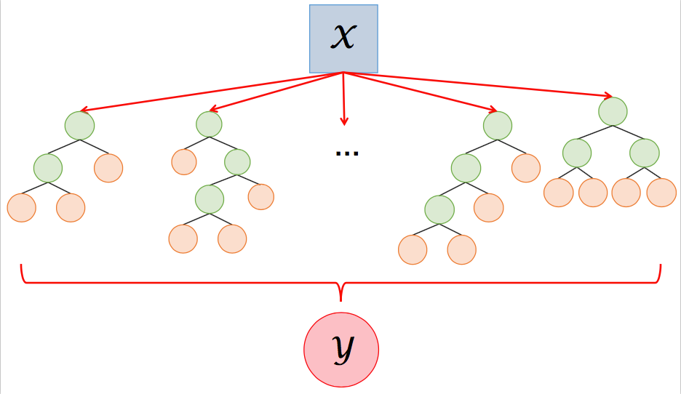
Building a QRF
Non-linear relationships
Incorporates habitat correlations

Slide 12
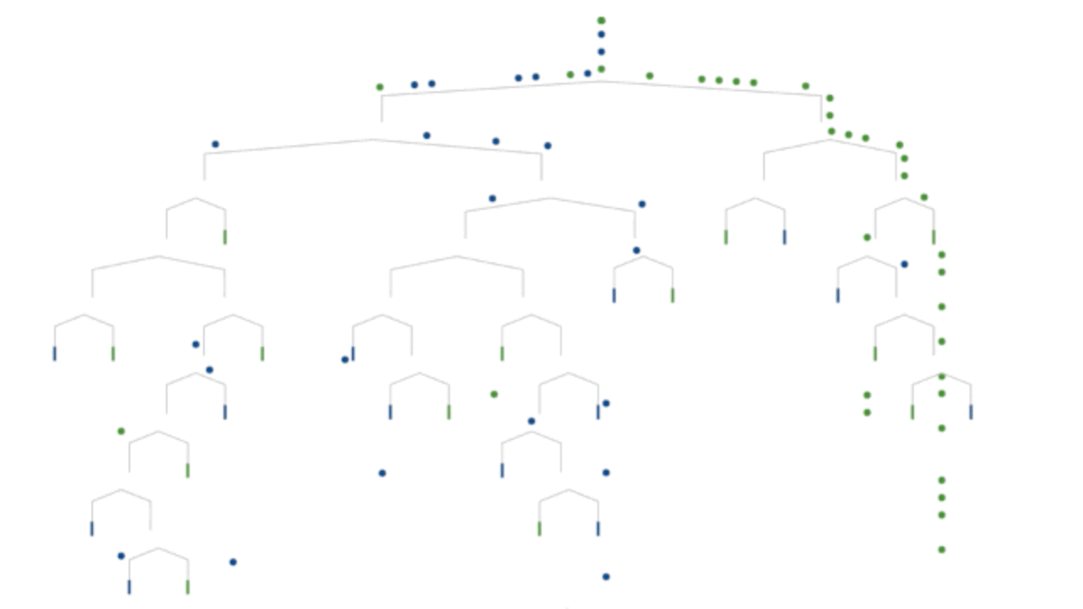
Building a QRF
Test using remaining 30% of the data.
Run each site through the tree 1,000 times.
Harvest the upper quantile (e.g., 90%) of density estimates to reflect capacity.

Slide 13
Quantile Random Forest – Empirical Evaluation

Slide 14
Quantile Regression Forest – Empirical Evaluation

Slide 15
Quantile Random Forest – Empirical Evaluation

Slide 16
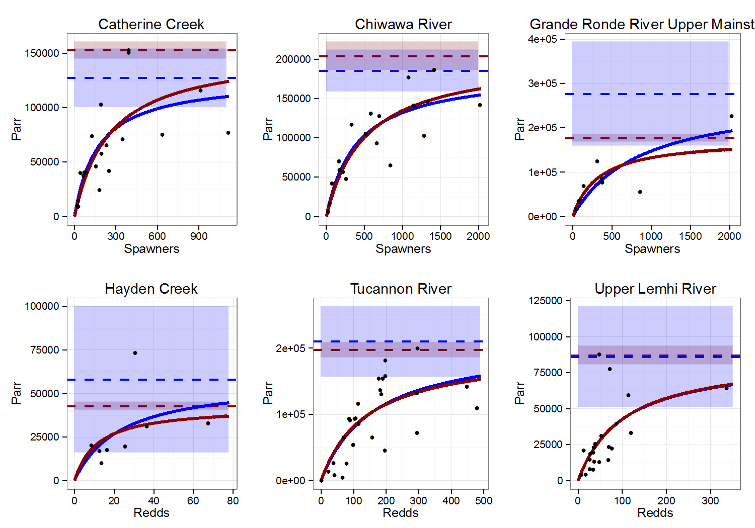
Quantile Regression Forest – Empirical Evaluation
Same model applied across the CRB.

Slide 17
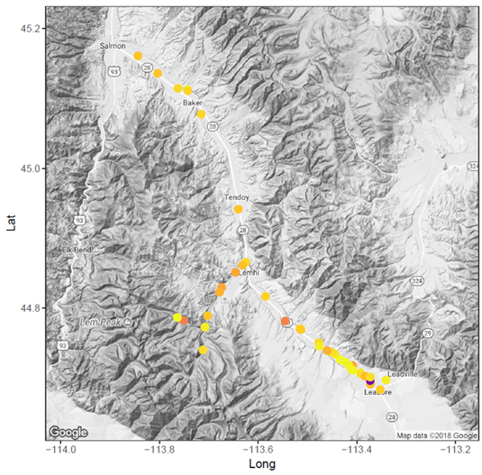

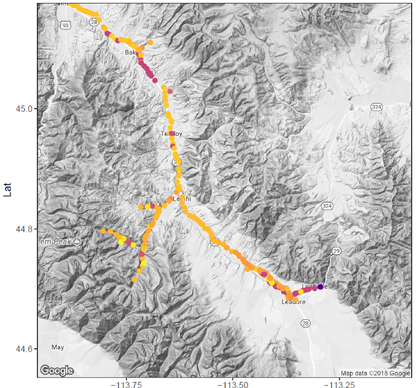

Slide 18
3. Summarize available capacity by watershed and life-stage

Slide 20
REQUIRED – AVAILABLE = CAPACITY DEFICIT

Slide 21
Chinook Salmon Capacity Limitations
Redds
Summer Parr
Winter Presmolt

Slide 22
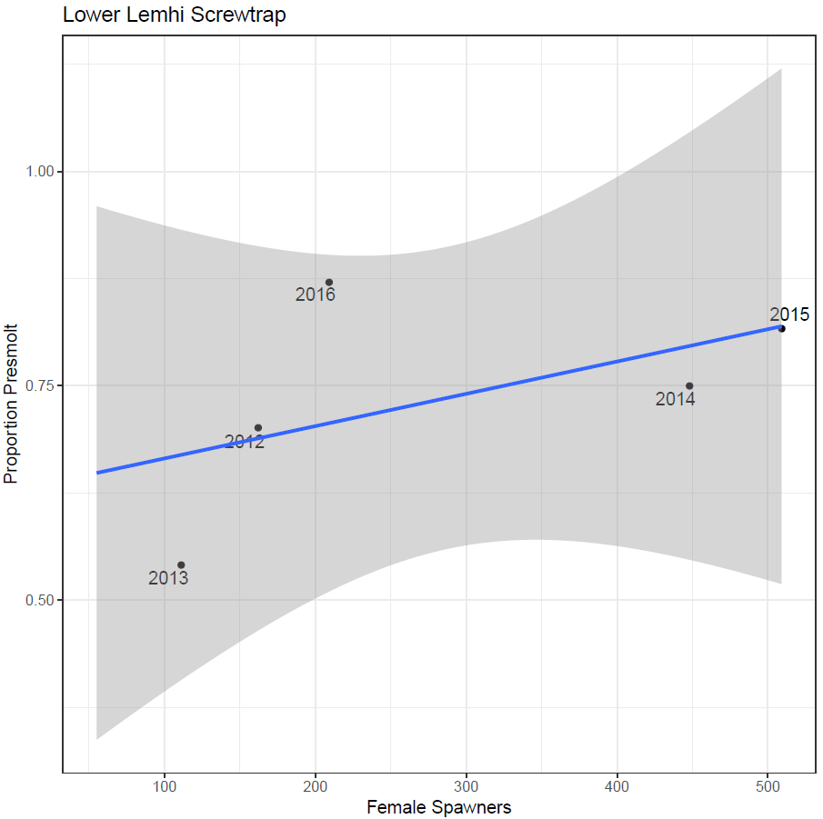
Chinook Salmon Capacity Limitations

Slide 23
Quick Recap
Tributary habitat capacity is a demonstrated limiting factor.
We can’t support MAT adult abundance without tributary habitat restoration.

Slide 24

Relativity - why looks can be deceiving.

Slide 25
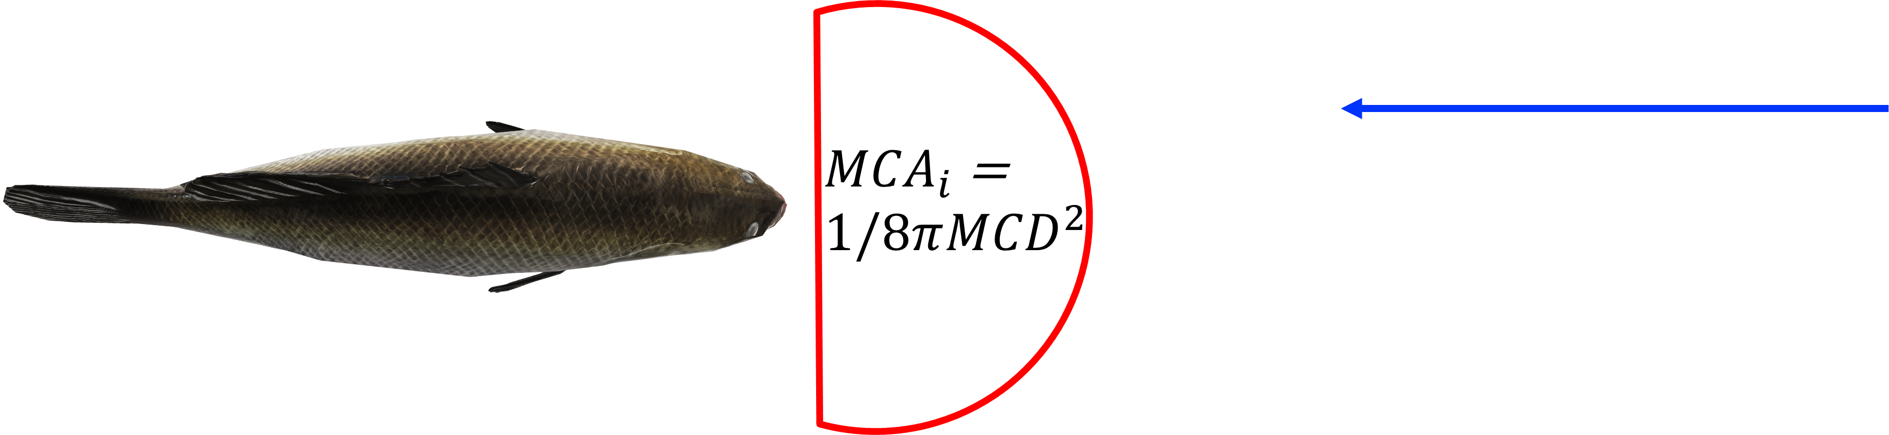
Bioenergetics - Mechanistic Fish/Habitat Relationship
Net Energy = Energy Consumed – (Capture Cost + Digestion Cost + Metabolism Cost)

Slide 26
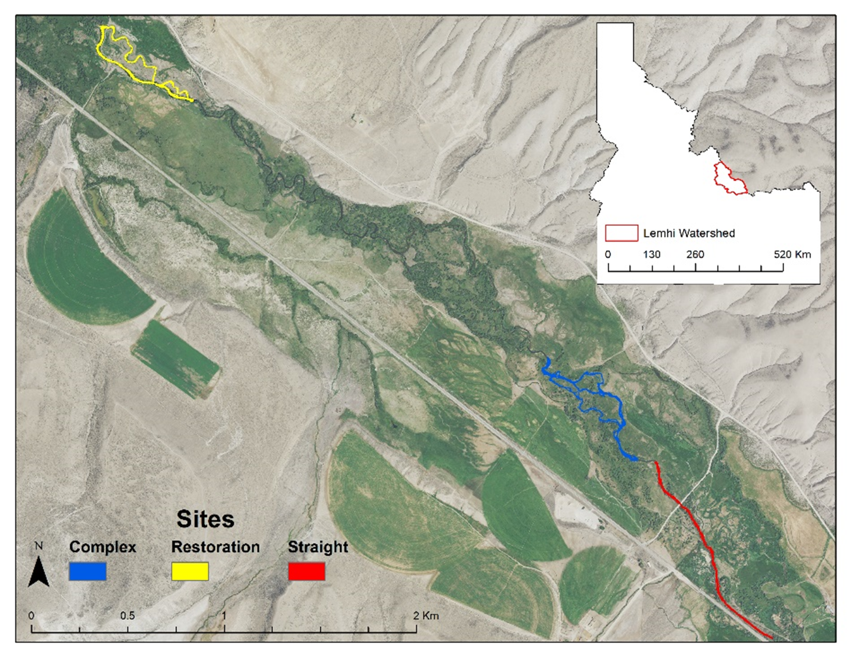
Bioenergetics

Slide 27
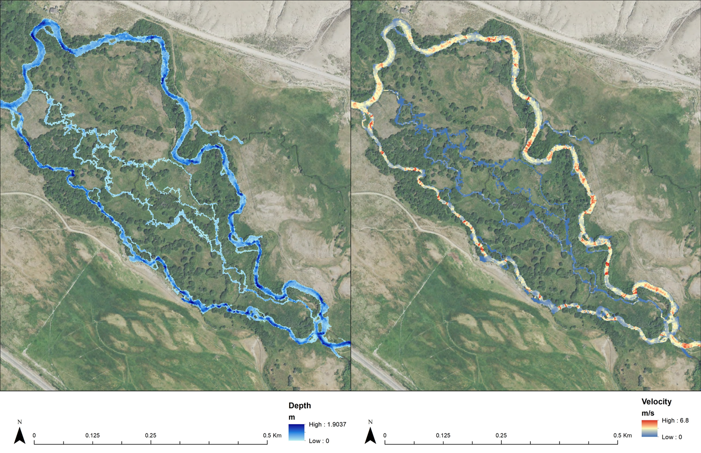

Slide 28
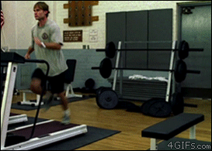
Velocity is the enemy of capacity…
Do not interpret velocity as “too much water.” Recall the capacity deficit – we need more water with less velocity.

Slide 29
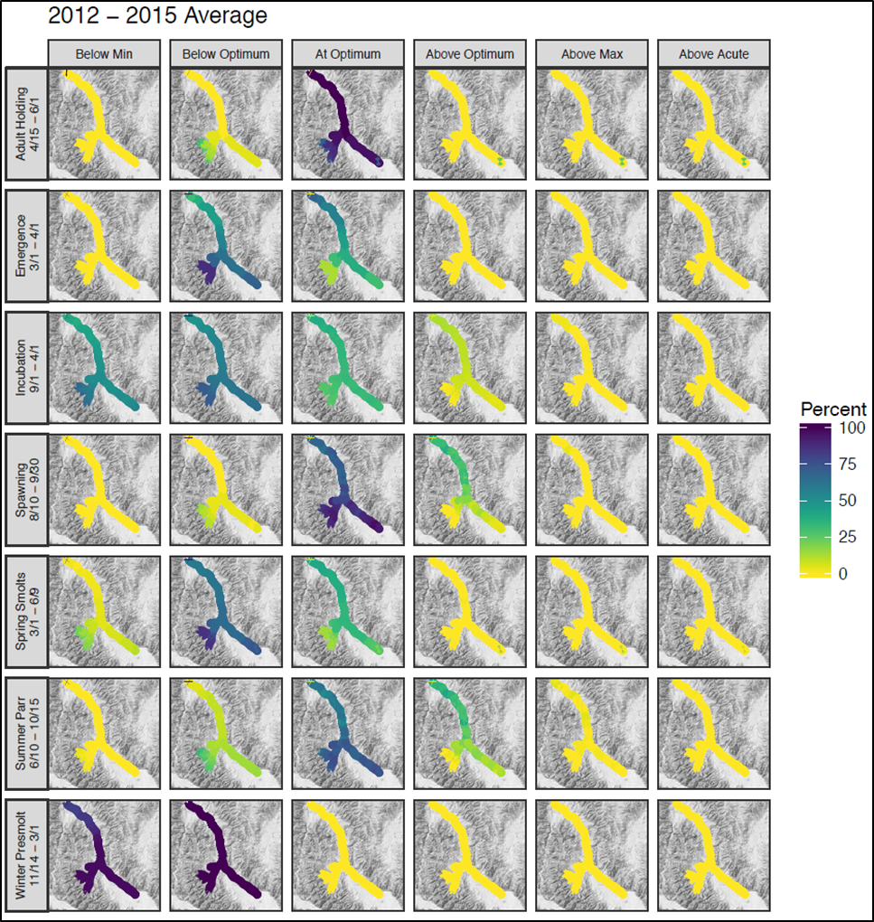
Temperature
Good News
Bad News

Slide 30
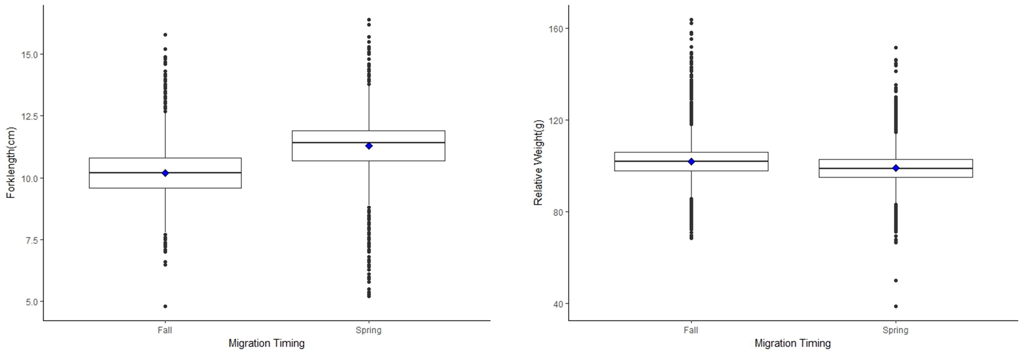
Temperature

Slide 31
Conclusions
The “4-H’s” – multiple choice?
  Hatcheries
  Hydro
  Harvest
  Habitat
Missing ocean and predation.
The “4-H’s” – multiple choice
  Hatcheries
  Hydro
  Harvest
  Habitat
  All of the above

Slide 32
Conclusions
You cannot achieve sustainable recovery without tributary habitat restoration.

